Slide 1
1
Notes:
Welcome to course!
Introduce yourself
Introduce other facilitators
Ask delegates to BRIEFLY! introduce themselves:
Their name
Their role
Their time in the NHS
(Keep a tally of how many years experience in the room – will use later)
Before we start there are a few important housekeeping points I need to run through…

Slide 2
RightCare, Shared Decision Making and Health Coaching
Robert Ferris-Rogers
Delivery Partner, NHS RightCare
19th and 26th September 2016

Slide 3
What’s important to you today
about this session?

Slide 4
What is NHS RightCare?
Highlights variation in health outcomes and spend by comparing CCGs to their most similar peers
Helps health economies to identify areas of opportunity where there is unwarranted variation
Supports increased value in population healthcare

Slide 6
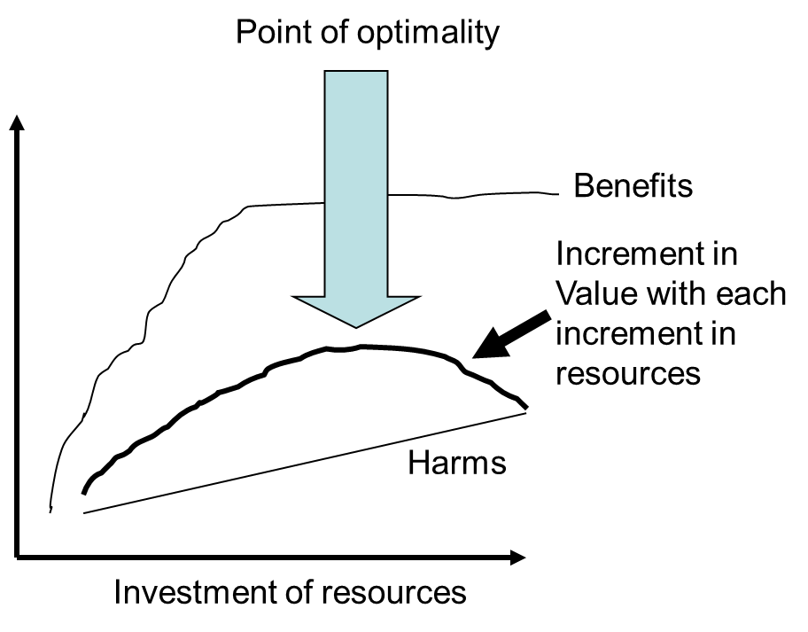
Where is best value? Donabedian’s Point of Optimality
Notes:
Benefits taper off, harm-done-to-treat is a straight line. If value is a balance between the two then there is a point of optimality, beyond which value decreases. At some point the lines cross….

Slide 7
So, where is the Point of Optimal Value?
BENEFIT
HARM
Resources
CLINICAL
ECONOMIC
VALUE
Necessary appropriate inappropriate futile
High Low Zero Negative
Notes:
Do we know? We know it isn’t at zero or negative economic value – so eradicating that activity is a starting point – chemo in the last weeks of life, proportion of hip and knee replacements. Need to find out where this activity is happening = variation data. Add to intervention variation, prevention, detection, management, spend and processing of healthcare variation that we also have and you begin to draw a picture of where an organisation, health economy or system is regularly at the wrong end of the variation scale. This is Where to Look for optimal improvement…

Slide 8
Increasing Value
Personalised value, determined by how well the decisions relate to the values of each individual
Allocative, determined by how the assets are distributed to different sub groups in the population
Between programme
Between system
Within system
Technical, determined by how well resources are used for all the people in need in the population

Slide 9
Shared Decision Making is…..

Slide 10
Shared decision making is a conversation, based on partnership, that brings patients and their clinicians together to share:
The clinician’s expertise, such as treatment, care or support options, evidence, risks and benefits, and;
What the patient knows best: their preferences, personal circumstances, goals, values and beliefs

Slide 11
Essential and ideal elements of Shared Decision Making
Makoul & Clayman 2006

Slide 12
What are we trying to avoid?
Patients
Making decisions in the
face of avoidable
ignorance
Clinicians:
Poorly ‘diagnosing’ patients’ preferences leading to underuse and waste
Poor Decision Quality
Mulley, Trimble and Elwyn, 2012

Slide 13
https://vimeo.com/117377437

Slide 14
Ask 3 Questions
Discussion with the people close to you about the video
What are your reflections on the ‘Ask 3 Questions’ approach
How could this be used in collaboration with health coaching?
What would be a powerful coaching question?

Slide 15
Shared Decision Making
A model for clinical practice
Initial Preference
Deliberation
Informed Preference
Choice Talk
Option Talk
Decision Talk
Preference Construction
Patient Decision Support
Brief inside, extensive outside the encounter

Slide 16
The Inter-relationship between shared decision making and health coaching
Behavioural change techniques
and goal setting
Evidence on effective
treatments and risk
Conversations based on partnership between clinician and patient using a coaching approach
Health coaching
Shared decision making

Slide 17
Finally a ‘Call to Action’ for Shared Decision Making

Slide 18
Insert renal call to action film

